Slide 1
MPEG

Slide 2
MPEG
Moving Picture Experts Group
Established in 1988

Slide 3
MPEG Overview
MPEG-1 : a standard for storage and retrieval of moving pictures and audio on storage media
MPEG-2 : a standard for digital television
MPEG-4 : a standard for multimedia applications
MPEG-7 : a content representation standard for information search
MPEG-21: offers metadata information for audio and video files

Slide 4
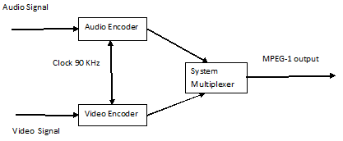
MPEG-1
First standard to be initialized for video compression was MPEG-1 for interactive video on CDS and for digital audio broadcasting.
MPEG has three components:
  Audio
  Video
  System, which integrates the two.

Slide 5
MPEG-1 Video Compression
Encoding each frame separately with JPEG removes spatial redundancy.
This is used where there is a need to access each frame randomly, such as editing video productions leading to 8- 10 Mbps compressed bandwidth.
Additional compression can be achieved by taking advantage of the fact that consecutive frames are almost identical.

Slide 6
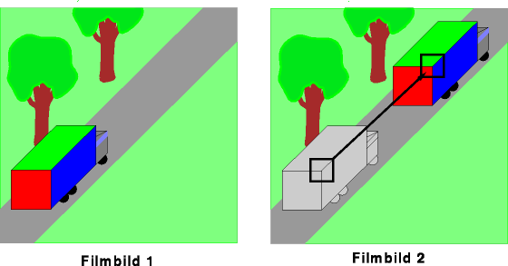
MPEG video compression
movie picture 1
movie picture 2

Slide 7
MPEG video compression
High similarity of 2 successive pictures
    => correlation
Same pixel´s movement in Camera turns
    =>motion compensation

Slide 8
MPEG-1 Frame Types
I (Intra-coded) frame: Self-contained, JPEG encoded; appears periodically.
P (Predictive) frame: Block-by-block difference with the preceding I or P frames.
B (Bidirectional) frame: Difference with the preceding and following I or P frames.
D (DC-coded) frame: Block averages used for fast forward.

Slide 9
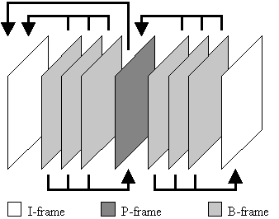
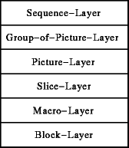
The macro layer
I – Frame, P – Frame or B – Frame?

Slide 10
The macro layer
I – Frames:
    intra coded image
    highest amount of data
    coding is very similar to a JPEG picture
    can be processed independent from other frames
    have a specified distance to the next I-Frame

Slide 11
The macro layer
B – Frames:
    bi-directionally interpolated image
    lowest amount of data
    most frequent type of frame
    depending on the previous or following P / I-Frame
    can also depend on the previous and following frame

Slide 12
The macro layer
P – Frames:
    predicted image
    medium amount of data
    difference to the previous I – Frame is stored
    have motion compensation ability

Slide 13
The macro layer
Motion Compensation in P – Frames :
I - Frame
P - Frame

Slide 14
Five parts of MPEG 1
Part 1: Combining video and audio inputs into a single/multiple
data stream
Part 2: Video Compression
Part 3: Audio Compression
Part 4: Requirements Verification
Part 5: Technical report on the software implementation of the
Parts 1 - 3

Slide 15
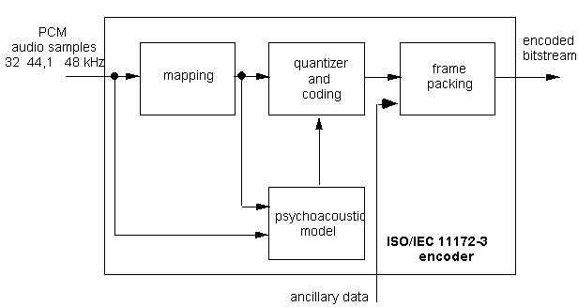
Basic Structure of Audio Encoder
Note: A decoder basically works in just the opposite manner

Slide 16
Processes of and Audio Encoder
Mapping Block – divides audio inputs into 32 equal-width frequency subbands (samples)
Psychoacoustic Block – calculates masking threshold for each subband
Bit-Allocation Block – allocates bits using outputs of the Mapping and Psychoacoustic blocks
Quantizer & Coding Block – scales and quantize (reduce) the samples
Frame Packing Block – formats the samples with headers into an encoded stream
Notes:
Mapping-divide into 32 subbands, or frequency samples
Psychoacoustic-…below which noise is imperceptible to the human ear (Map & Psycho can be done independently
Bit-Allocation-total noise to mask ratios can be minimized, over all the channels and subbands
Frame Packing – header includes bit allocation and scaling information (scale factor)
Quantizer & Coding – scaled and quantized according to the bit allocation

Slide 17
MPEG-1 Layers I, II, III
MPEG layer differences lie in processing power and resulting audio/sound quality
  Mp1 – little processing needed, poor quality
  Mp2 – minimal processing, “okay” quality
  Mp3 – massive processing, high “CD” quality

Slide 18
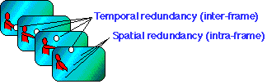
MPEG-2 Video Compression Overview
Compression: Eliminating Redundancies
  Spatial Redundancy
    Pixels are replicated within a single frame of video
  Temporal Redundancy
    Consecutive frames of video display images of the same scene
Notes:
Video compression is based on eliminating repeating information, thus, making a file smaller without effecting its quality.
Spatial redundancy occurs because parts of the picture (called pixels) are often replicated (with minor changes) within a single frame of video.
Temporal redundancy arises when consecutive frames of video display images of the same scene. It is common for the content of the scene to remain fixed or to change only slightly between successive frames.

Slide 19
MPEG-2 Video Compression Overview
Four Video Compression Techniques:
1. Pre-processing
2. Temporal Prediction
3. Motion Compensation
4. Quantization

Slide 20
MPEG-2 Video Compression Overview
Pre-processing
  Filters out unnecessary information
    Information that is difficult to encode
    Not an important component of human visual perception
Notes:
MPEG compression is accomplished by four basic techniques: pre-processing, temporal prediction, motion compensation, and quantization coding.
Pre-processing filters out non-essential visual information from the video signal, information that is difficult to encode but not an important component of human visual perception.

Slide 21
MPEG-2 Video Compression Overview
Temporal Prediction:
  Uses the mathematical algorithm Discrete Cosine Transform (DCT) to:
    Divide each frame into 8X8 blocks of pixels
    Reorganize residual differences between frames
    Encode each block separately
Notes:
Temporal redundancy (between frames) Motion Estimation is usually the most time consuming part of MPEG encoding. Discrete Cosine Transformation (DCT) is a process of representing original data as a linear sum of basic cosine functions with different frequencies. Each image delivers one brightness and two color signals per pixel. The DCT converts these signals into frequency coefficients containing the color and brightness information. The signals can then be compressed more easily.

Slide 22
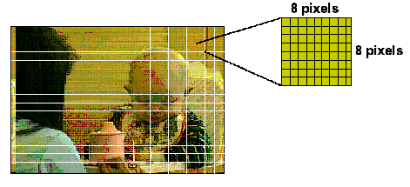
MPEG-2 Video Compression Overview

Slide 23
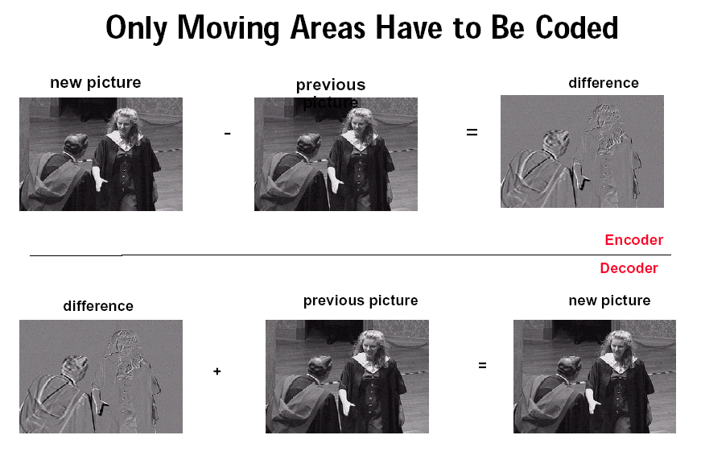
MPEG-2 Video Compression Overview

Slide 24
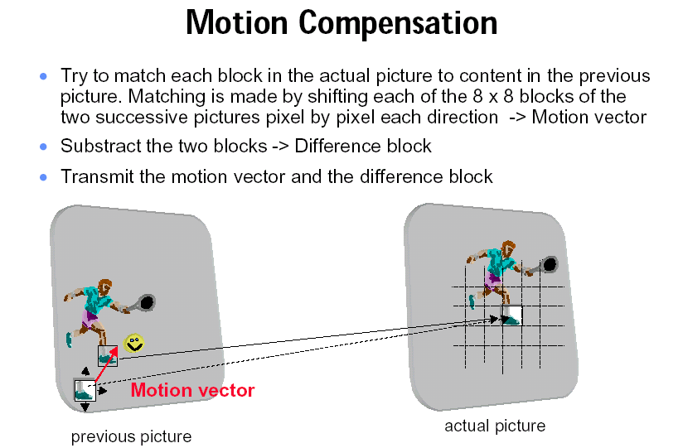
MPEG-2 Video Compression Overview

Slide 25
MPEG-2 Video Compression Overview
Quantization:
  Refers to DCT coefficients
  Removes subjective redundancy
  Controls compression factor
  Converts coefficients into even smaller numbers
Notes:
After converting the input block of 8x8 pixels into an 8x8 block of DCT coefficients, the quantization is applied to the DCT block. The lower frequency region takes minimum quantization, the higher frequency region takes maximum quantization. Since the accuracy of DCT coefficient will be reduced by quantization, the degree and the shape of quantization is design for different picture type (Intra or NonIntra) due to not cause visible damage to the reconstructed video.
Quantization is the use of complex mathematical operations to ensure that image parts that are important to the human eye are represented precisely and irrelevant information is represented with less precision.

Slide 26
MPEG-2 Video Compression Overview
Where It Is Used:
Multimedia Communications
Webcasting
Broadcasting
Video on Demand
Interactive Digital Media
Telecommunications
Mobile communications

Slide 27
MPEG-4 Overview
Submergence
  Handle specific requirements from rapidly developing multimedia applications
Advantages over MPEG-1 and MPEG-2
  Object-oriented coding
Notes:
Submerged: MPEG-4 was first introduced in 1998 and takes advantage of nearly a decade in improvements to the MPEG algorithm compression. It is a graphics and video compression algorithm standard that is based on MPEG-1 and MPEG-2 and Apple QuickTime technology.
Advantages: The main difference of the new standard MPEG-4 with respect to MPEG-1 and MPEG-2 in terms of requirements and functionalities are that it goes beyond the goals of making the storage and transmission of digital audiovisual material more efficient, by compressing data. It specifies a description of digital audiovisual scenes in the form of objects that have certain relations in space and time. MPEG-1 and MPEG-2 were all designed for the compression of linear content. The MPEG-4 standard introduced what is termed the systems introducing object orientation and this allows for the secure delivery of interactive multimedia.

Slide 28
Features & Functionalities
Object Oriented
  Primitive Audiovisual Objects are Coded
Low Data Rate
  Allows for high quality video at lower data rates and smaller file size
Interoperability
  Opens methods in playing with audiovisual scenes
Notes:
Object-Oriented: in the way that audiovisual objects coded allows MPEG-4 to combine 2-D, 3-D graphics, animation and interactivity with audiovisual and other powerful tools like content security, targeting, and personalization.
Low Data Rate: MPEG-4 video is optimized for low (<64 kbps), intermediate (64-384kbps), and high ( 384-4Mbps) bitrates.
Interoperability: The MPEG-4 standard consists of a collection of tools that support application areas. The method that MPEG-4 uses to code object creates conformance points that provide the basis for interoperability. MPEG-4 does not target a major “killer application”, but what it does is that it opens methods in playing with audiovisual scenes, creating reusing, accessing and consuming so that audiovisual content will become easier. Currently companies such as Apple, Cisco, Kaseena, Phillips and Sun Microsystems, along with others are joining forces to increase the deployment of interoperable solutions.

Slide 29
Targeted Applications
Digital TV
  TV logos, Customized advertising, Multi-window screen
Mobile multimedia
  Cell phones and palm computers
TV production
  Target viewers
Games
  Personalize games
Streaming Video
  News updates and live music shows over Internet
Notes:
Digital TV: MPEG-4 allows increased text, picture, audio, or graphics to be controlled by the user so that entertainment value can be added to certain programs or provide valuable information unrelated to the current program to the interest of the viewers: Examples of increased functionalities would be TV station logos, customized advertising, multi-window screen formats allowing display of sports stats or stock quotes using data-casting.
Mobile multimedia: This is in regards to the enormous popularity of cell phones and palm computers. MPEG-4 deals with mobile devices in the manner that it can deal with the narrow bandwidth and limited computational capacity. (does this by improving error resilience, code efficiency, and flexibility of resources)
TV Production: Since MPEG-4 focuses on coding of audiovisual objects instead of rectangular linear video frames, it allows high quality and more flexible scenes. An example is how local TV stations could inject regional advertisement video objects that would be better suited when international programs are broadcasted depending on the targeted viewers.
Games: In dealing with games the main focus is user interaction. MPEG-4’s role is it allows video objects in games to be even more realistic. An example: the creator can personalize games by using personal video data bases linked in real-time into the games.
Streaming Video: Streaming video over the internet is becoming very popular. Examples are news updates and live music shows. Bandwidth is limited due to the use of modems and transmission reliability is an issue when packet loss may occur. MPEG-4 has improved on scalability of bitstream in term of the temporal and spatial resolution that (Larisa) has mentioned previously about.

Slide 30
MPEG 7
Another ISO/IEC standard being developed by MPEG
Content representation standard for information search
Makes searching the Web for multimedia content as easy as
searching for text-only files
Operates in both real-time and non real-time
environments

Slide 31










Why do we need MPEG-7 ?
Support for Advanced Query
Fast & Accurate Access
Visual
Audio
Sketch
Personalized Content Production and Consumption
+
N e e d
Content Management
Automation

Slide 32
MPEG-7: What Is It ?
THE MPEG 7 STANDARD
IS NOT a STANDARD for
FEATURE EXTRACTION/MATCHING
IS NOT a COMPRESSION Standard
similar to MPEG-1/2/4 or their Extension
Content Description of Various Audio Visual Information
Types of Audio Visual Information
  Audio, Speech
  Moving video, still pictures, graphics
  Information on how objects are combined in scenes

Slide 33
MPEG-7: Application Areas
Storage and retrieval of audiovisual databases (image, film, radio archives)
Broadcast media selection (radio, TV programs)
Surveillance (traffic control, surface transportation, production chains)
E-commerce and Tele-shopping (searching for clothes / patterns)
Remote sensing (cartography, ecology, natural resources management)
Entertainment (searching for a game, for a karaoke)
Cultural services (museums, art galleries)
Journalism (searching for events, persons)
Personalized news service on Internet (push media filtering)
Intelligent multimedia presentations
Educational applications
Bio-medical applications

Slide 34
MPEG-7: Main Elements
Descriptors (D)
  syntax and semantics of each feature representation
Description Schemes (DS)
  structure and semantics of the relationships between components
Description Definition Language (DDL)
  creation of new DS’s
  modification/extension of existing DS’s

Slide 35
MPEG-7: Main Elements (2)
DDL
Instantiation
DS1
<Object>
<Label/>
<Definition/>
.
.
</Object>
DS2
DS2
Systems
DS3
D1
D2
D3
0001100

Slide 36
MPEG-7: Systems
It defines tools to:
provide for efficient storage and transport
synchronize between content and description
manage and protect intellectual property

Slide 37
MPEG-7: DDL and its Components
Description Definition Language:
  Creation of the Ds and DS’s: XML Schema & MPEG-7 Extensions
  Instantiation of XML
XML Schema:
  Data types
  Simple and Complex types
  Elements, attributes
  Inheritance, Abstract types
MPEG-7 extensions:
  Array and Matrix data type

Slide 38
MPEG-7: Audio
Sound Effects
Music Instrument Timbre
Spoken Content
Melody Contour

Slide 39
MPEG-7: Visual (1)
Color
  quantization, dominant, scalable, color-structure, layout, GoF/GoP
Texture
Shape
  region-based, contour-based, 3D
Motion
  camera motion, motion trajectory, parametric motion, motion activity

Slide 40
MPEG-7: Visual (2)
Localization
  spatio temporal
Others
  face recognition

Slide 41
Thank you…

